Slide 1

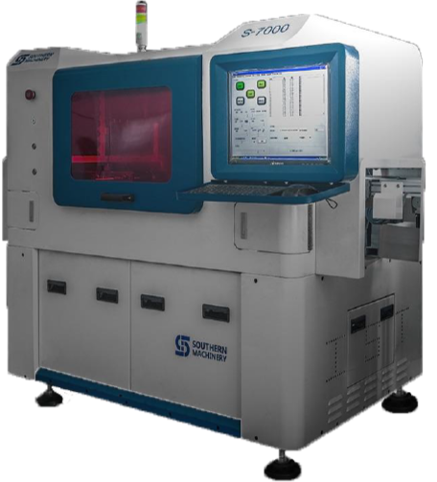
S-7000 Eyelet / PIN insertion machine solutions
The S-7000 Eyelet /Pin insertion machine is a custom-made model for various size Eyelet or PIN automatic assembly to PCB. PC controller, servo motor drive, vision programming. SMEMA connector.

Slide 2
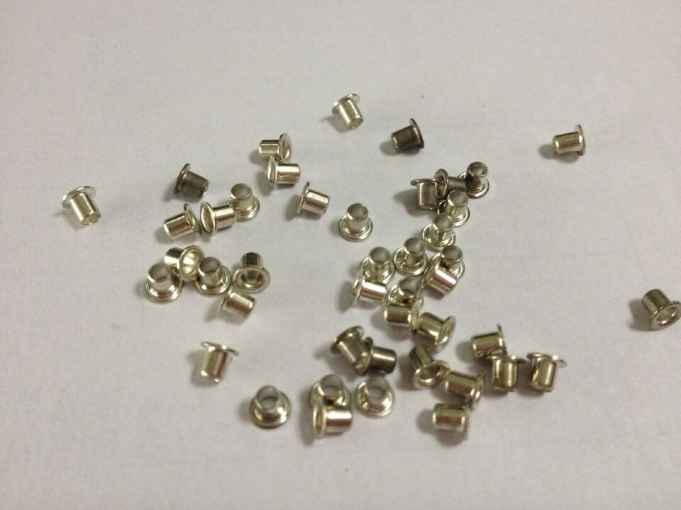
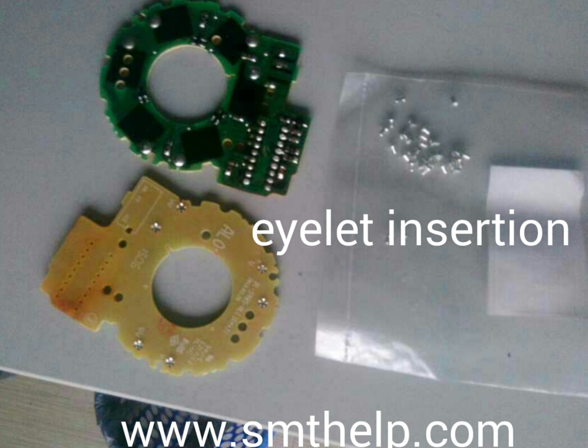
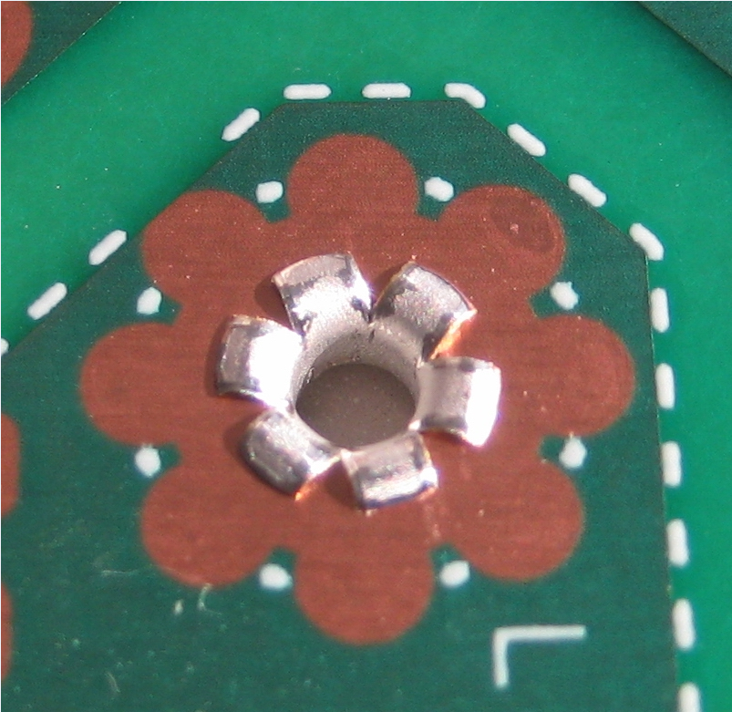
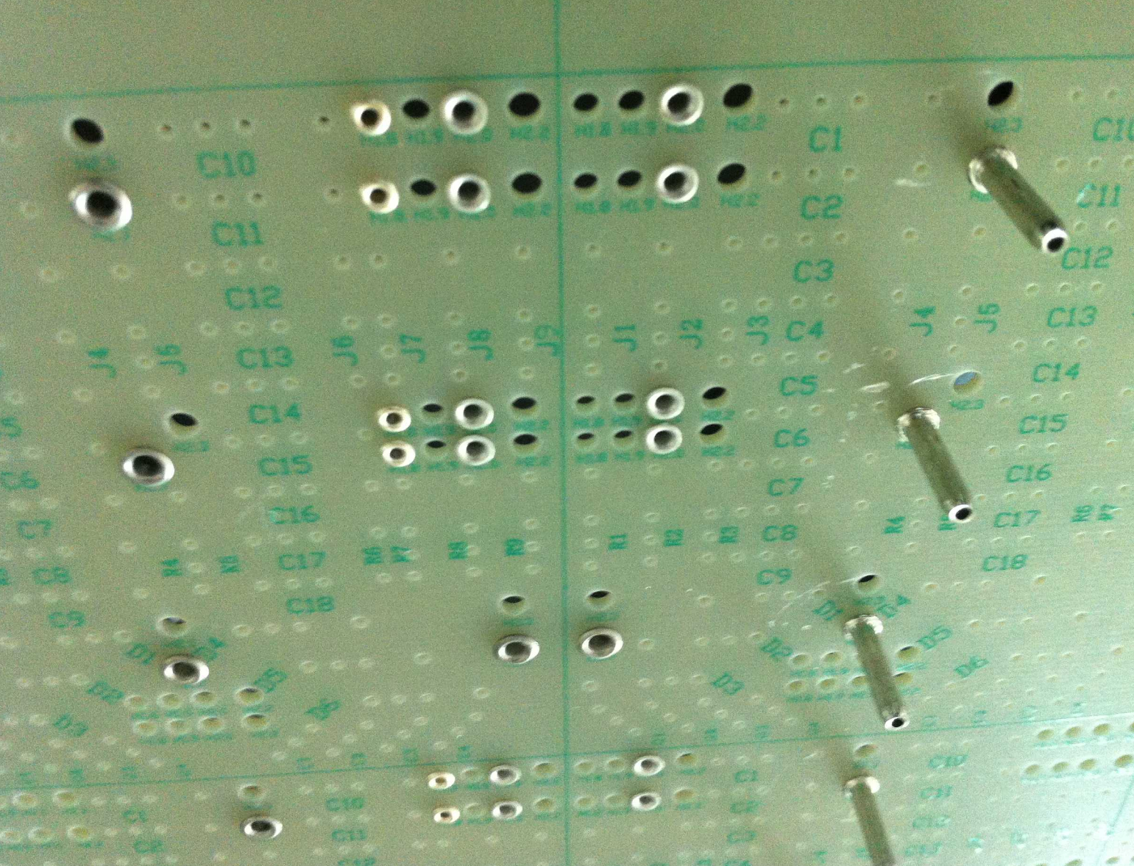
Eyelet/Pin Insertion PCB
Eyelet/Pin
Eyelet/Pin after insert to PCB

Slide 3
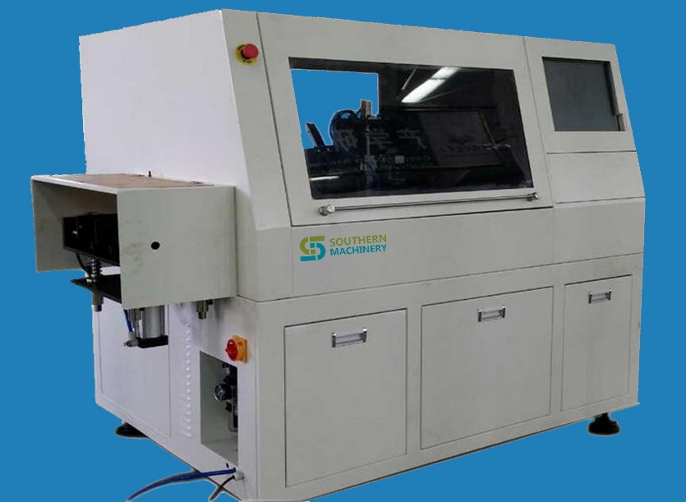
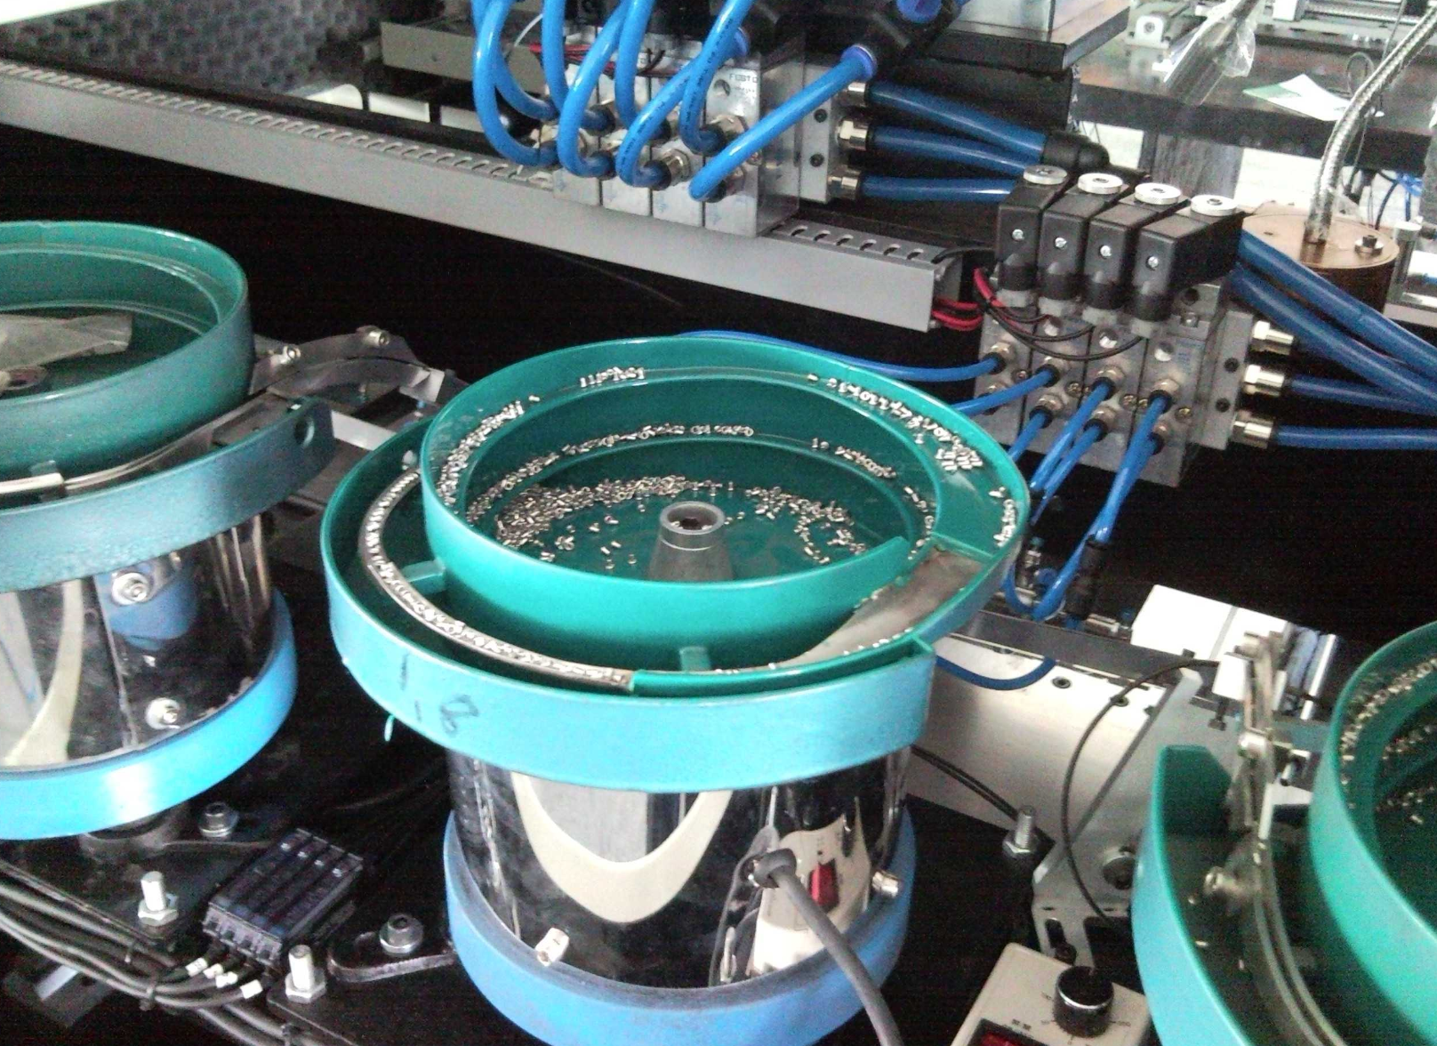
Machine Introduction
The S-7000 offers consistently high precition insertion to improve throughput, product quality and output per floor space, while reducing associated labor costs and time requirements to provide greater returns.
⚫ Completely controlled by computer, English operation system, based on Windows ,convinent to operate, fast, simple, easy to learn.
⚫ Use machine vision technology, on-line programming, auto correction, auto recognizing MARK point.
⚫ Use AC servo system and optimized circuit, eliminating the unstability caused by circuit error, ensure the system is stable and rapid also power economic
⚫ PCB auto loading

Slide 4
Machine in Details
Feeder
Inserion head
Vision programming
Clinching base(PCB support& miss check)

Slide 5
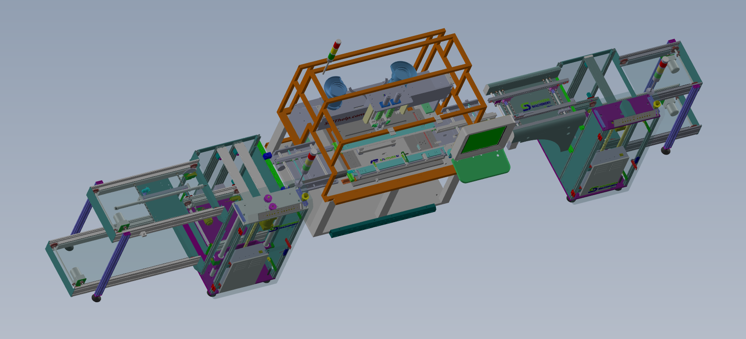
Machine Introduction
Please click to see 3D madel:
2 Eyelet Insertion machine with Loader unloader

Slide 6
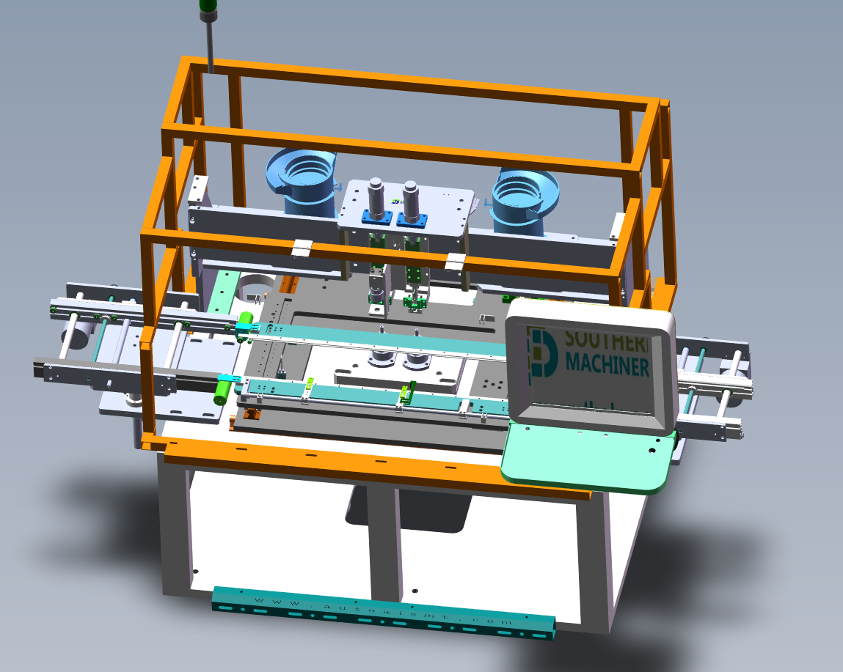
PCB Handling ASSY
Conveyor( L to R in-line)
X/Y Table

Slide 7
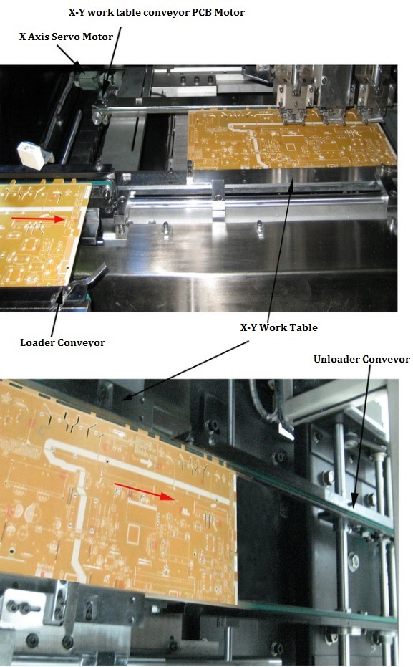
PCB Handling ASSY
Auto PCB loading
Servo X-Y working Table
1. The Loader conveyor transport the PCB to X-Y work table, X-Y servo motor to drive the X-Y work table positioning.
2. After base part of Insertion Head finish the insertion (Detection system will inspect the insertion successfully into the next step, if not finish then repeat this action), X-Y work table will transport the completed insertion PCB to Unloader conveyor.

Slide 8
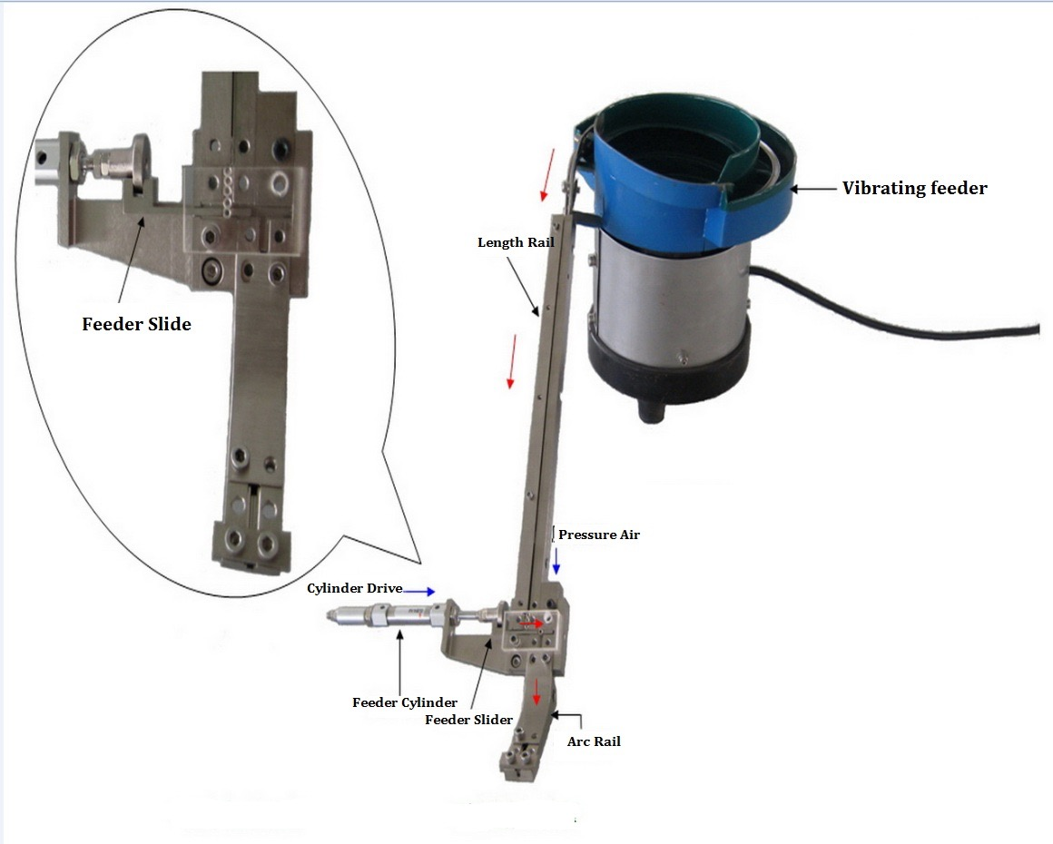
Eyelet Feeding ASSY
Eyelet/Pin S-7000E - In Detail
1. Vibrating feeder sequence bulk rivet/Eyelet pin to length rail.
2. Use Eyelet/Pin's weight through length rail slide down to feeder slider.
3. Feeder Cylinder drive the feeding slider to push the eyelet/pin on arc rail one by one.
4. Pressure air put eyelet/pin through arc rail and push it to the material Clip of insertion Head.

Slide 9
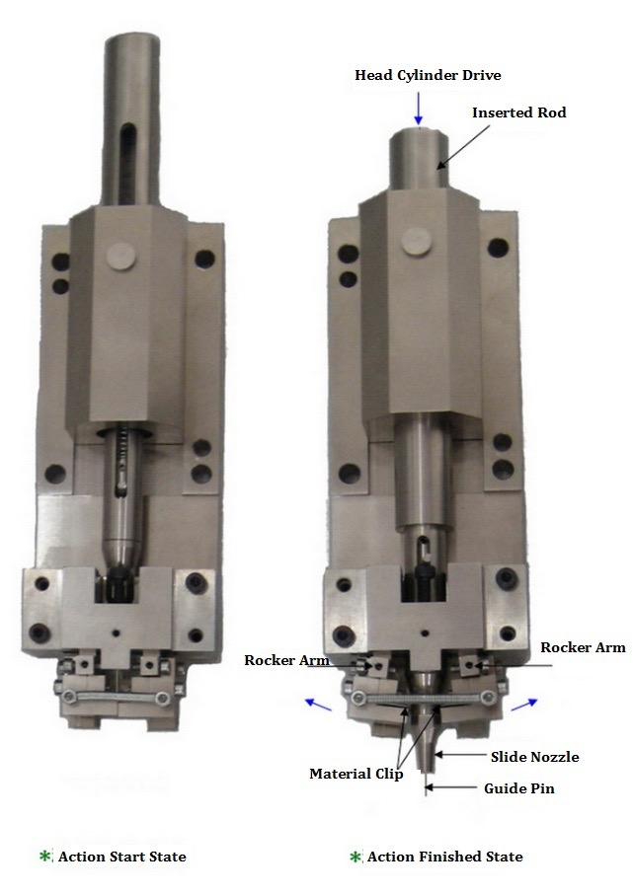
Machine Insertion Head ASSY
Connect to motor
Head driver
Programming camera
Nozzle
R cutter
L cutter
Pedestal

Slide 10
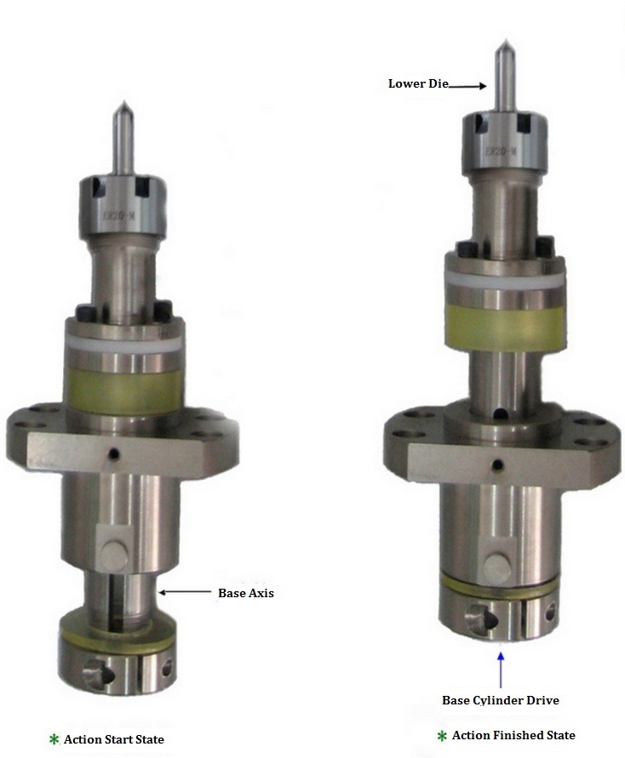
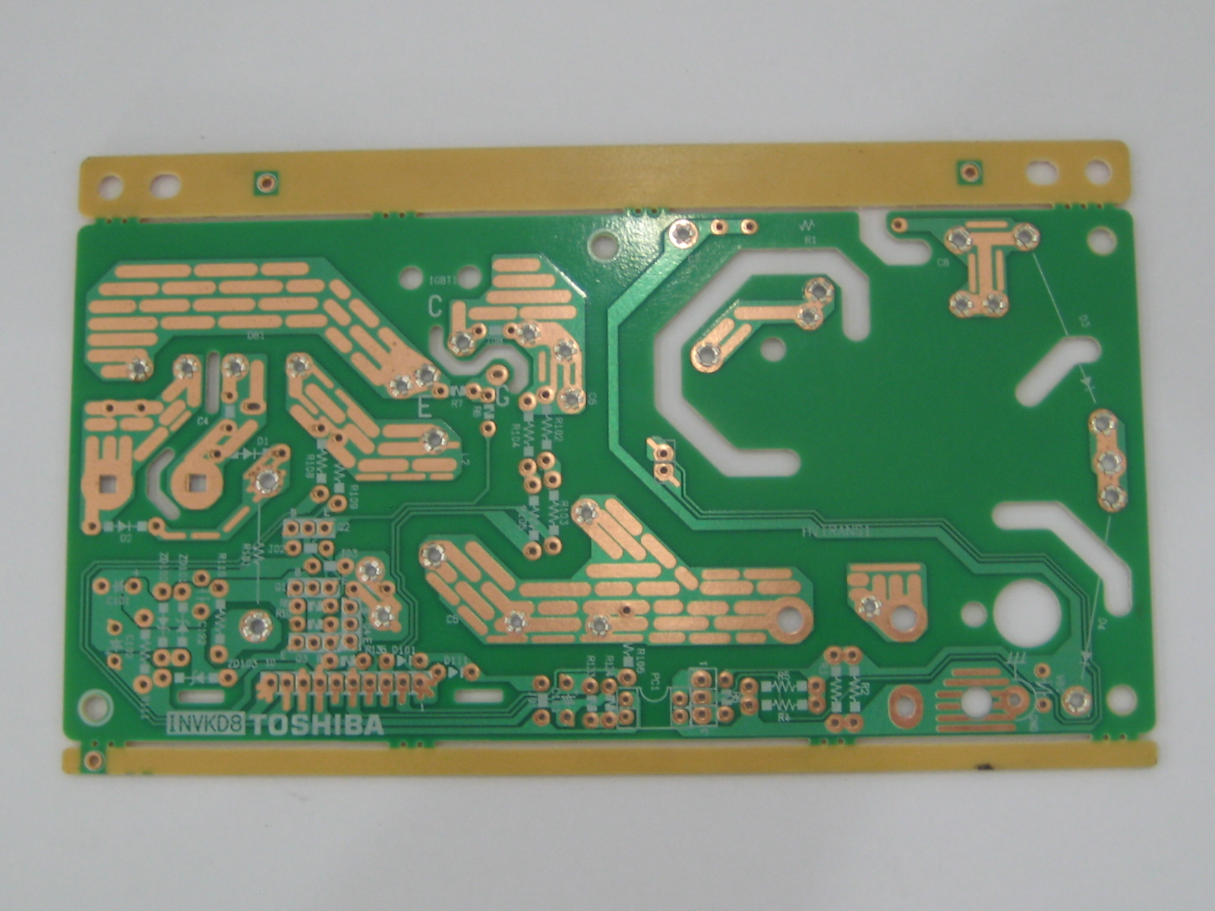
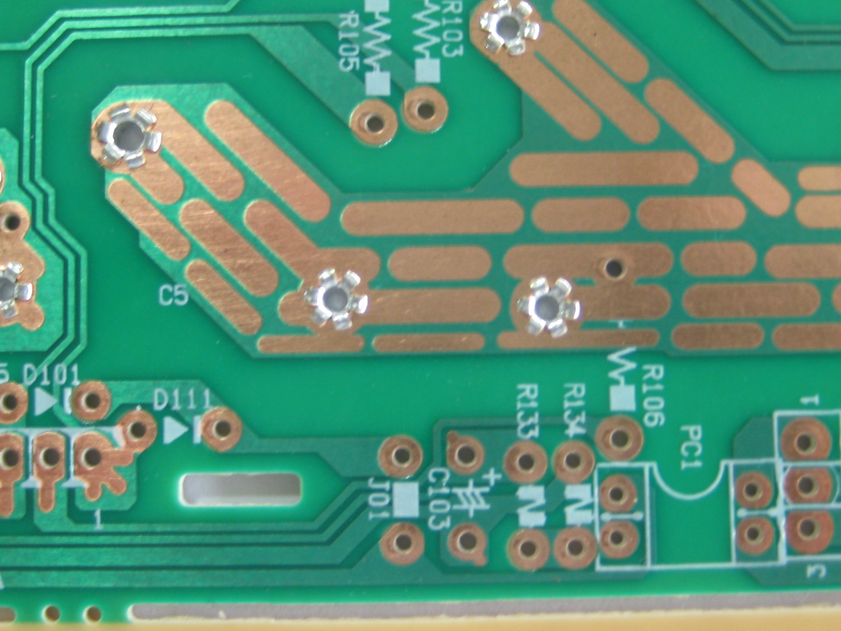
Machine Clinching base
The base cylinder to drive the base axis to up move, lower die insert to eyelet/pin bottom, the blade of lower die cutting the eyelet/pin bottom and pressing to blossom process.

Slide 11
Machine Specifications
Machine size:1450mm*1300mm*1600mm(L*W*H)
Speed: Max 4000 Component per hour
PCB size: 50*50~400*400 (mm)
PCB thickness:0.79~2.36 mm
Power: 220V 50/60hz single phase, with UPS
Safe distance between 2 components: ≥ 2mm
Air pressure: 0.6-0.8MPA
Drive system: AC servo,AC motor
Insert position programming & calibration:
machine vision by 0.3M CCD
PCB transfer : L to R / R to L(optional) in-line
Weight: 1000KG
Others: Windows system/Data transfer USB port/SMEMA connector

Slide 12
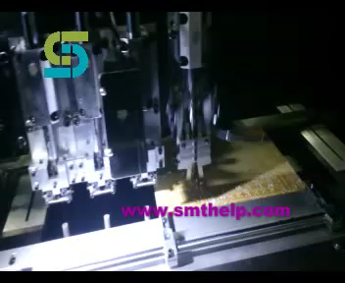
S7000 Machine working in Customer

Slide 13






Southern Machinery
Southern Machinery was established in Shenzhen China in March 2011. We provide professional automatic insertion machines tailor-made for your Electronic Manufacturing Factory. The Southern Machinery team has over 20 years of experience in the electronics manufacturing industry. We uphold the design philosophy of American auto insertion machines and offer the highest quality of customer service. Depending on your needs, we will conduct any level of EMS design work for you so that you can focus on the manufacturing and sale of your electronic products while we do the set-up work for you.
Our Client

Slide 14
Best pre-sales / after sales service support
— Worldwide Support
— Free Installation/ Training
— 1 day lead-time (spare parts)
— 1 Month customize solution

Slide 15
Welcome Inquiry
Please visit
www.smthelp.com
Find us more
https://www.facebook.com/autoinsertion
Know more our team
https://cn.linkedin.com/in/smtsupplier
Welcome to our factory in Shenzhen China
See more machine working video, please Youtube
Auto Insertion
Google
Auto+insertion, to get more informations
Looking forward to your email
info@smthelp.com

